Slide 1


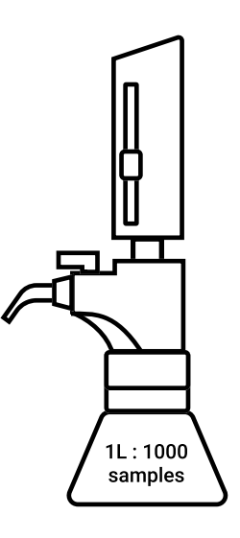

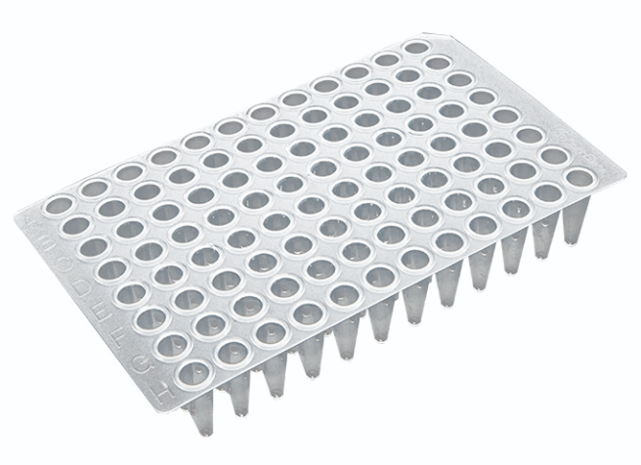
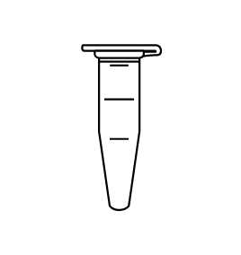
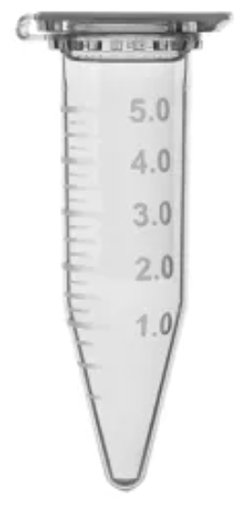

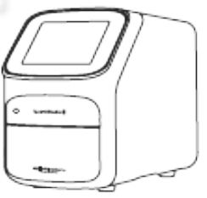
FloodLAMP Direct RNA Assays
QuickColor™ LAMP Test
Heat 95°C for 8min
+ 2 µL Sample
Pos and Neg Controls
Pooled Dry Swab Samples
Eluted Sample
1 mL
Primer-Guanidine Solution
550µL
1.5
mL
Heat 65°C for 25min
100X Inactivation Solution
10 mL
Colorimetric LAMP MM (NEB M1804)
655 µL
CLAMP Reaction
Mix
1025 µL
CLAMP Reacion: 23 µL
Sample: 2µL
1X Inactivation Saline Solution
1 L total volume
dispense 1 mL per sample tube
48 rxn volumes
+ 2 µL Sample
EasyPCR™ Test
Pos and Neg Controls
Nuclease-free Water
400 µL
.9% Saline
154 mM
30.8 mL 5M NaCl in H20 to 1 L
5X PCR Primers
300 µL
5
mL
96 rxn volumes
PCR Reaction Mix
1800 µL
qPCR Machine80min
PCR Reaction 18 µL
Sample: 2µL
PCR MM:
1000 µL
RT:
100 µL
(NEB Luna
E3006)

Slide 2
FloodLAMP Direct RNA Assays
QuickColor™ LAMP Test
Heat 95°C for 8min
+ 2 µL Sample
Pos and Neg Controls
Pooled Dry Swab Samples
Eluted Sample
1 mL
Primer-Guanidine Solution
1080 µL
5
mL
Heat 65°C for 25min
100X Inactivation Solution
10 mL
Colorimetric LAMP MM (NEB M1804)
1286 µL
CLAMP Reaction
Mix
2366 µL
CLAMP Rxn: 25 µL
CLAMP MM: 23 µL
Sample: 2µL
1X Inactivation Saline Solution
1 L total volume
dispense 1 mL per sample tube
96 rxn volumes
+ 2 µL Sample
EasyPCR™ Test
Pos and Neg Controls
Nuclease-free Water
400 µL
.9% Saline
154 mM
30.8 mL 5M NaCl in H20 to 1 L
5X PCR Primers
300 µL
5
mL
96 rxn volumes
PCR Reaction Mix
1800 µL
qPCR Machine80min
PCR Rxn : 20 µL
PCR MM: 18 µL
Sample: 2µL
PCR MM:
1000 µL
RT:
100 µL
(NEB Luna
E3006)

Slide 3
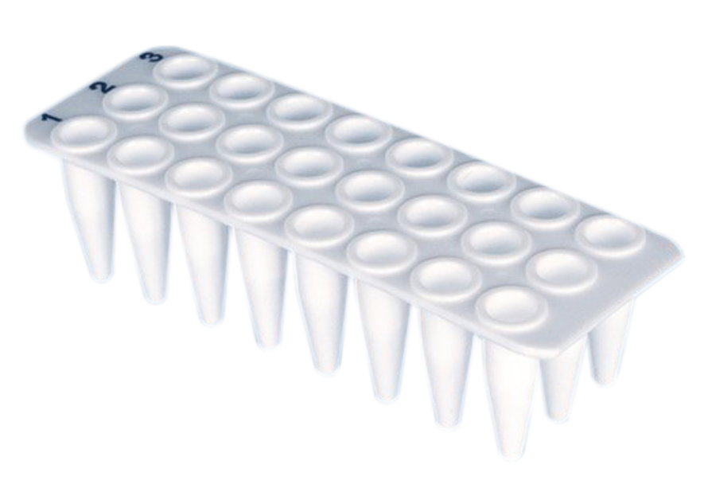
Validation: First Run
QuickColor™ LAMP Test
VL24CLAMP_210430
+ 2 µL Sample
Pos and Neg Controls included in 24-tube sample plate
Primer-Guanidine Solution
275 µL
Heat 65°C for 25 min
Colorimetric LAMP MM (NEB M1804)
327 µL
CLAMP
Reaction
Mix
602 µL
(73 µL Fill)
CLAMP Rxn: 25 µL
CLAMP MM: 23 µL
Sample: 2µL
24 rxn volumes
EasyPCR™ Test
VL24PCR_210430
+ 2 µL Sample
Pos and Neg Controls included in 24-tube sample plate
Nuclease-free Water
79µL
24 rxn volumes
5X PCR Primers
105 µL
PCR Reaction Mix
473 µL
(57 µL Fill)
qPCR Machine80 min
PCR Rxn : 20 µL
PCR MM: 18 µL
Sample: 2µL
(NEB Luna
E3006)
PCR MM:
263 µL
PCR RT:
26.3 µL

Slide 4

GCP Sample
Gamma Contrived Positive Diagram
AN Swab Dried > 20 min
Gamma Contrived Positive v1.3
freeze (-80)
3rd
Add 100 µL 2nd
GBD in 1.5mL Tube
83 x 105µL
1,000 cp/µL
1st
GCP Sample in 5mL Transport Tube,
100cp/µL GBEI
900 µL
Inactivate Sample Following Normal Inactivation Procedures and Create Dilution Series
AN Swab Dried > 20 min
1X Inactivation Saline Solution
Add 1 mL 1st
2nd
X 3
NSS Samples
NSS Sample in 5mL Transport Tube

Slide 5


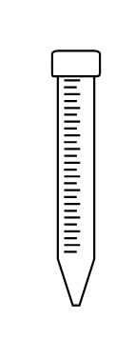
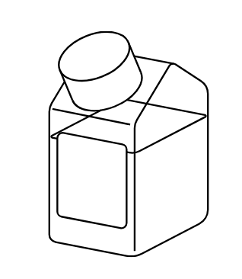
100X Inactivation Solution
XL Diagram
+ 100mL NFWater
A) Weigh
TCEP - Water
100X Inactivation Solution XL
Batch Record v1.0
Key Source
Entire Contents
TCEP:
25g
B) + 122.5 mL (Standard) NFWater
.5M TCEP in 500 mL glass bottle
D) + 40.0 mL (Standard)
3rd
1st
freeze (-20)
10N NaOH:
1 L
Aliquot
COMPONENT VOLUMES
Row | Step | Standard | Adjusted
(A) | TCEP | 25 g
(B) | Supplemental Water Volume = (A) * 8.9 | 122.5 mL
(C) | EDTA Volume = (A) * 2.79 | 69.8 mL
(D) | NaOH Volume = (A) * 1.6 | 40.0 mL
2nd
C) + 69.8 mL (Standard)
100X IS in 500mL glass bottle
TCEP: .25M
EDTA: .1M
NaOH: 1.15N
100X Inactivation Solution in 15mL Falcon Tube:
10 mL x 34
.5M EDTA:
100 mL

Slide 6

1X Inactivation Saline Solution Diagram
freeze (-20)
From Inactivation Protocol v5.1
10mL
~1/100th Volume
100X Inactivation Solution
2nd
1 mL
+ 48.5 mL MilliQ or NFWater
1 L
Volume
1st
Dry Swab Sample in 5mL Transport Tube
1X Inactivation Saline Solution
5M Saline:
1.54mL
.9% Saline in 50mL Falcon
50mL x 1
Saline (.9%) Batch Record v1.0

Slide 7

UPDATE- Keep Old
Twist Positive Control Diagram
TPC - Twist Positive Control Batch Record v1.0
+ 4.895 mL NFWater
Use 2µL per Amp Reaction.
Key Source
freeze (-80)
Aliquot
freeze (-80)
Twist 102019, ~1e6cp/µL
100 µL
+ 140 uL NFWater
Twist in 5mL Tube
TSPC
5 µL x 19
Aliquot
Twist PC:
Twist: 1,000 cp/µL 1ug/µL
Twist Aliquoting Batch Record v1.0
freeze (-80)
freeze (-80)
freeze (-80)
Aliquot
Add 100µL
TRPC
Twist: 1,000 cp/µL TRNA: 1ng/µL
in 1.5mL Screw Cap
490 µL x 10
TFPC
in 1.5mL Screw Cap Tubes
20 µL x 24
TPC
in 1.5mL Screw Cap
Twist:125cp/uL
TRNA: .125ng/uL
10 µL x 16
Total Human RNA, Thermo 4307281, 50ng/µL
100 µL
TRPC Source Stock Batch Record v1.0
TFPC Source Stock Batch Record v1.0

Slide 8

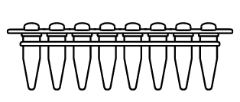
Gamma Blue Dil.
GBD Diagram
Gamma Blue Dil Batch Record v1.1
+ 8.745 mL NFWater
Key Source
Add one
5 µL Aliq
freeze (-80)
Aliquot
freeze (-80)
Aliquot
BEI, NR-52287 1.75e6 cp/µL, .5mL
GBEI in PCR Strip Tube
100 x 5 µL
GBD in 1.5mL Tube
83 x 105µL
1,000 cp/µL
GBD in 30mL Chub:
8.75mL
1,000 cp/µL
Gamma Red Hot
1.75e6 cp/µL
Batch Record v1.0

Slide 9
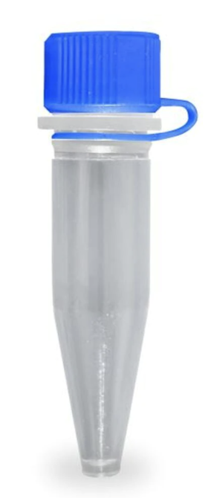
Gamma 10K Dil.
G10K Diagram
Gamma 10K Dil Batch Record vX
+ 870 µL NFWater
freeze (-80)
Key Source
Add one
5 µL Aliq
Aliquot
freeze (-80)
Aliquot
BEI, NR-52287 1.75e6 cp/µL, .5mL
GBEI in PCR Strip Tube
100 x 5 µL
G10K in 1.5 mL screw cap:
875 µL
10,000 cp/µL
G10K in 1.5mL Tube
32 x 27 µL
10,000 cp/µL
Gamma Red Hot
1.75e6 cp/µL
Batch Record v1.0

Slide 10
Primer-Guanidine Solution Diagram
Batch Record v2.0
+ 1 mL NFWater
8 rxns / Aliquot
Key Source
freeze (-20)
Dry As1e
LAMP Primer Set
Add
+ 9.4 mL NFWater
Aliquot
PGS in 1.5 mL Tubes:
92 µL x 136
24 rxns, 9% over.
+ 1 mL NFWater
freeze (-20) or fridge
OR
Key Source
Add
Aliquot
24 rxns / Aliquot
freeze (-20)
Dry N2 LAMP Primer Set
10X LAMP Primer Mix
3 mL x 1
12.6mL PGS in 30 mL Chub
OR
+ 1 mL NFWater
Add
PGS in 1.5 mL Tubes:
275 µL x 45
24 rxns, 9% over.
Key Source
Aliquot
Dry E1 LAMP Primer Set
10X LAMP Primer Mix
Add 200 µL
96 rxns / Aliquot
freeze (-20)
PGS in 1.5 mL Tubes:
1120 µL x 11
96 rxns, 11% over.
The number of LAMP Primer Sets used can be increased and the rest of the batch record increased
PGS Info:
Primers: 2.38X
GUD: 95.1 mM
6M Guanidine-HCl
100 mL

Slide 11
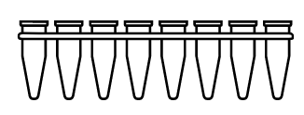
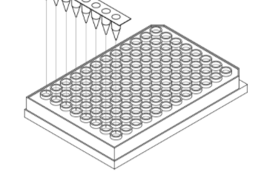
Colorimetric Assay Diagram
FIX
CLAMP Assay v2.5
24 rxns
+ 2 µL Samples
PGS in 1.5mL Tube:
275 µL
73 µL x 8
x 3
Add 327 µL
CLAMP Reaction Mix in PCR Fill Strip (73 µL/tube)
CLAMP Rxn x 24:
CLAMP MM: 23 µL
Sample: 2µL
CLAMP Reaction Mix in 5mL Tube: 602 µL
24 rxns 9% over.
Colorimetric LAMP MM:
1.32 mL
96 rxns
+ 2 µL Samples
Add 1080µL
PGS in 1.5mL Tube:
1120 µL
72.5 µL x 8
CLAMP Reaction Mix in 5mL Tube: 2366 µL
96 rxns 7% over.
CLAMP Reaction Mix in PCR Fill Strip (290 µL/tube)
Add 1286 µL
CLAMP Rxn x 96:
CLAMP MM: 23 µL
Sample: 2µL
Colorimetric LAMP MM:
1.32 mL

Slide 12
Colorimetric Assay Diagram
FIX
CLAMP Assay v2.5
48 rxns
+ 2 µL Samples
PGS in 1.5mL Tube:
µL
146 µL x 8
Add µL
CLAMP Reaction Mix in PCR Fill Strip (146 µL/tube)
frozen(-20)
CLAMP Reaction Mix in 5mL Tube: µL
48 rxns 9% over.
CLAMP Rxn x 48:
CLAMP MM: 23 µL
Sample: 2µL
Colorimetric LAMP MM:
1.32 mL or less

Slide 13
Numbers need to be updated for whole Eurofins Genomics Kit
5X PCR Primers Diagram
Key Source
Key Source
+ 11.562 mL NFWater
100uM N1-F:
Total Vol: 1 mL
Add: 250 µL
100uM RP-F:
Total Vol: 500 µL
Add: 94 µL
Key Source
Key Source
freeze (-20)
Add
Aliquot
Aliquot
100uM N1-R:
Total Vol: 1 mL
Add: 250 µL
100uM RP-R:
Total Vol: 500 µL
Add: 94 µL
5X PCR Primers in 1.5mL Tube: 105.6µL x 10
24 rxns, 10% over.
5X PCR Primers in 30mL Chub 12.5mL
5X PCR Primers in 5mL Tube 1.1mL x 11
Key Source
Key Source
100uM N1-P:
Total Vol: 500 µL
Add: 125 µL
100uM RP-P:
Total Vol: 500 µL
Add: 125 µL
5X PCR Primer Source Stock v1.1
5X PCR Primers Working Stock v1.0

Slide 14
PCR Assay Diagram
PCR Assay v1.3
+ 2 µL Samples
NFWater
79.2µL
5X PCR Primers in 1.5mL Tube: 105.6µL
Add
57 µL x 8
18 µL
NEB E3006 Kit
Add 264 µL
PCR Reaction Mix in PCR Fill Strip (57 µL/well)
PCR Reaction Mix in 1.5mL Tube
472.5 µL
24 rxns, 9% over.
Luna PCR MM:
1 mL x 5
Add 26.4 µL
PCR Rxn : 20 µL
PCR MM: 18 µL
Sample: 2µL
Aliquot
LUNA RT:
500 µL
LUNA RT in 1.5mL Tube:
100 µL x 5

Slide 15
EXTRA

Slide 16
+ 100mL NFWater
+ 74 mL NFWater
100X Inactivation Solution
Diagram
Key Source
freeze (-20)
Entire Contents
100X Inactivation Solution
Batch Record v1.0
Aliquot
TCEP:
25g
.5M TCEP in 30mL Chub:
12 mL x 16
.5M TCEP in 250 mL glass bottle
TCEP Batch Record v1.1
Same Tube
+ 77.1mL NFWater
Aliquot
freeze (-20)
+ 47.9 mL
Aliquot
1 Aliquot
2nd
1st
100X Inactivation Solution in 1.5mL Tube:
1 mL x 24
10N NaOH:
1 L
3.83N NaOH in 250 mL glass bottle
3.83N NaOH in 15mL Falcon
7.2 mL x 17
100X IS in 30mL Chub
TCEP: .25M
EDTA: .1M
NaOH: 1.15N
NaOH Batch Record v1.0
1 Aliquot
Aliquot
.5M EDTA:
100 mL
.5M EDTA in 15mL Falcon
4.8 mL x 16
EDTA Batch Record v1.0

Slide 17
+ 2 µL Sample
Primer-Guanidine Solution
CLAMP Reaction Mix
CLAMP Rxn
CLAMP MM: 23 µL
Sample: 2µL
QuickColor™ LAMP Test
High Sensitivity (90%)
µLtra-high throughput
Ideal for serial screening
Uniquely scales without capital intensive instruments
Colorimetric LAMP MM
100X Inactivation Solution
Dry Swab Sample in 5mL Transport Tube
1X Inactivation Saline Solution
+ 2 µL Samples
5X PCR Primers
PCR Reaction Mix
PCR Rxn : 20 µL
PCR MM: 18 µL
Sample: 2µL
.9% Saline
Streamlined Sample Prep
Upfront swab pooling
Highly scalable, integrated processing
Same sample for both tests
NEB E3006 Kit
EasyPCR™ Test
Very high sensitivity (98%)
Medium throughput (1.5 hours/94)
Ideal for diagnostics/reflex/confirm
Luna PCR MM:
LUNA RT:

Slide 18
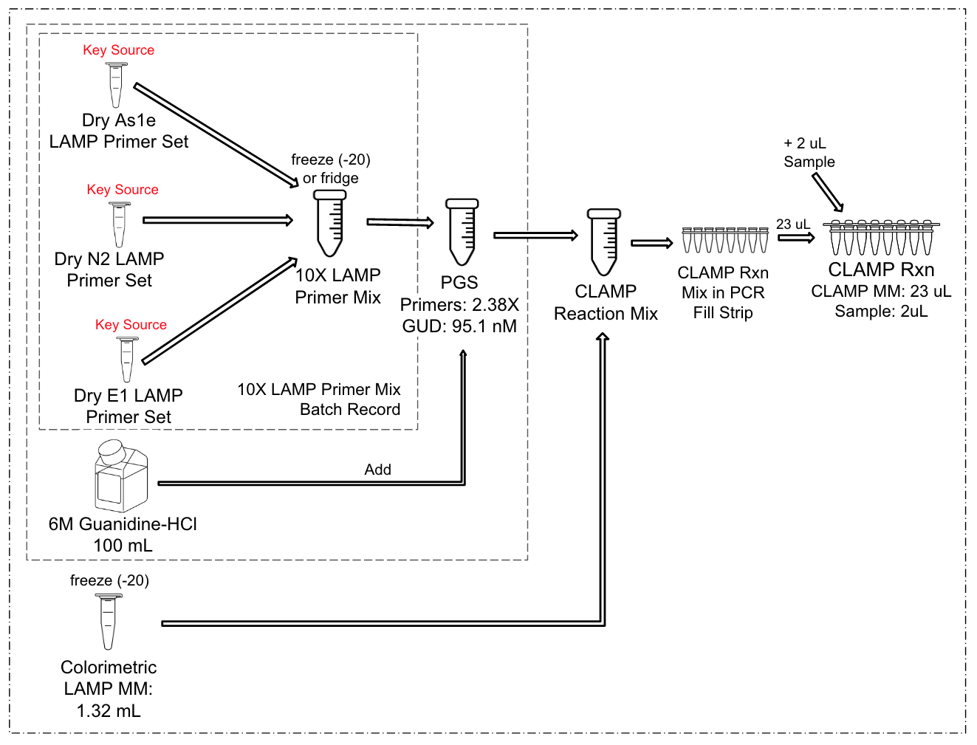
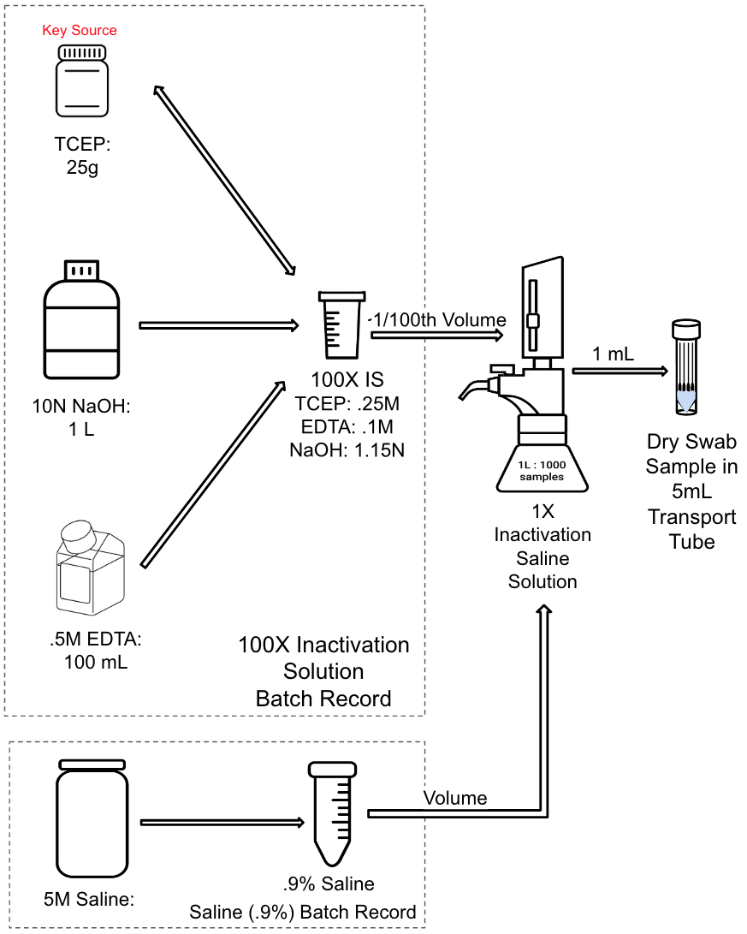
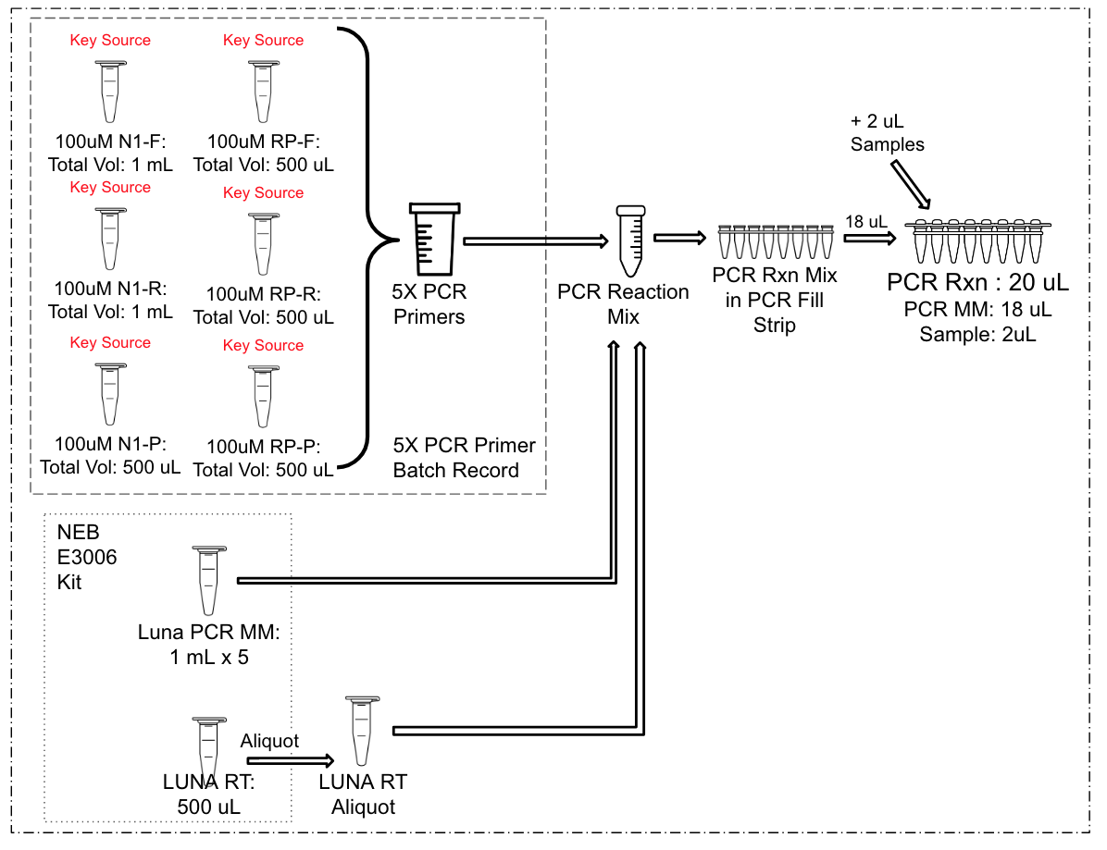

QuickColor™ LAMP Test
EasyPCR™ Test
Streamlined Sample Prep

Slide 19
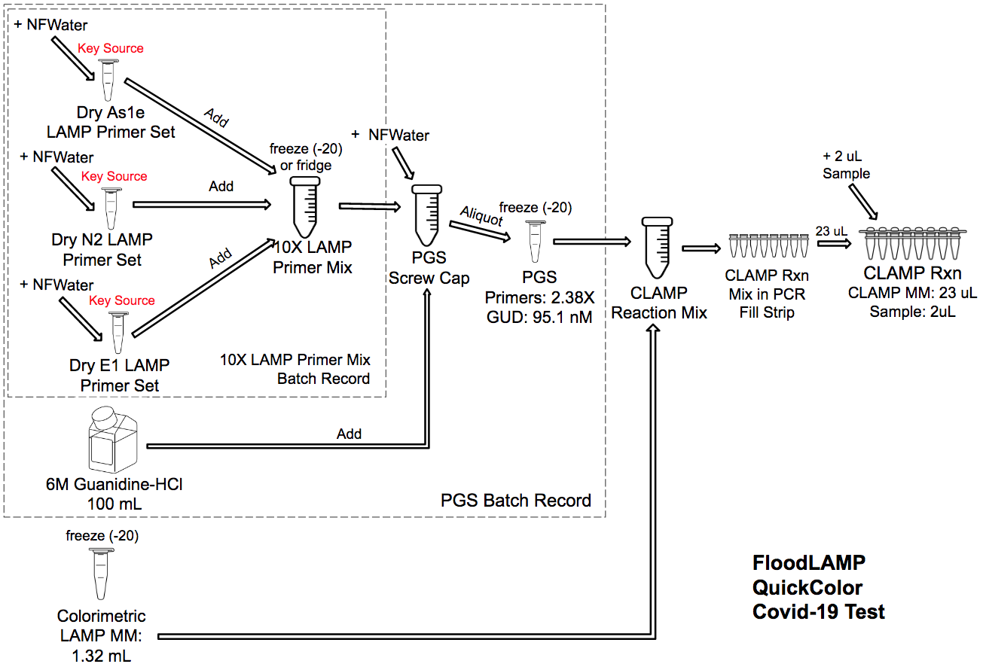
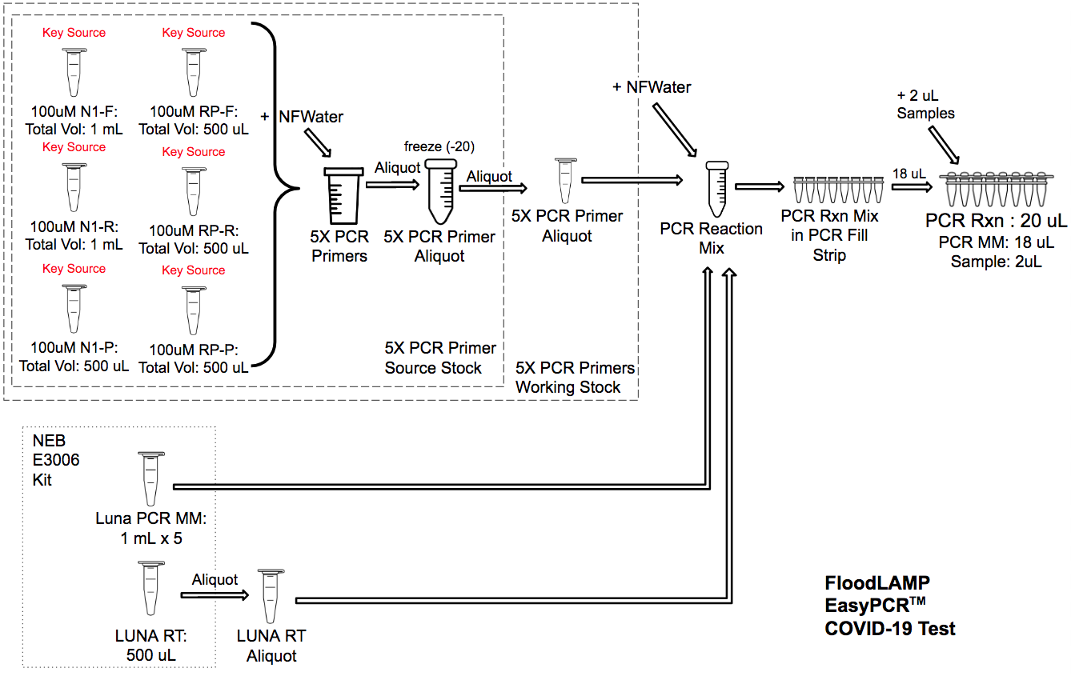
FloodLAMP Lab Playbook
Positives or Invalids from QuickColor™ Covid-19 Test Reflexed using FloodLAMP EasyPCR™ Covid-19 Test

